Slide 1
Linux Boot Camp
March 28-29
Cherry 207

Slide 2
Raspberry Pi / Linux Workshop
Ed Carr

Slide 3
Hardware Processors
Central Processing Unit (CPU) 64-bit Quad-Core 1.4GHz ARMv*

Slide 4
Hardware
Memory: 1 GB SDRAM (shared with GPU)
USB 2.0 ports: (4)
Video input: 15-pin MIPI camera interface (CSI) connector
Video outputs: HDMI (rev 1.3 & 1.4), 14 HDMI resolutions from 640×350 to 1920×1200
On-board storage: Micro SD slot
On-board wireless: 2.4GHz and 5GHz IEEE 802.11.b/g/n/ac wireless LAN, Bluetooth 4.2, BLE
LAN: Gigabit Ethernet over USB 2.0 (maximum throughput 300 Mbps)
Power: 5V/2.5A DC power input

Slide 5
Your Kit
Kit Includes: - New Raspberry Pi 3 B+ (RPi2) Quad-Core 1.2GHz 1GB RAM
On-board WiFi and Bluetooth Connectivity
32 GB Micro SD Card (Class 10) - Raspberry Pi Recommended Micro SD Card pre-loaded with NOOBS, USB MicroSD Card Reader
CanaKit 2.5A USB Power Supply with Micro USB Cable and Noise Filter - Specially designed for the Raspberry Pi 3 (UL Listed)
High Quality Raspberry Pi 3 Case, Premium Quality HDMI Cable, 2 x Heat Sinks, GPIO Quick Reference Card, CanaKit Full Color Quick-Start Guide

Slide 6
Build Your Pi Contents
Open Your Cana Kit Box
Your box should contain 3 boxes, a quick start guide and a GPIO reference guide card.
Open the Raspberry Pi box, be careful! Inside this box you should have a handouts, a safety guide and a quick start guide. Be very careful with the silver insulated bag and the pink bag. The silver bag contains your motherboard (raspberry pi) and the pink contains your SD card (operating system), it also contains heat sinks.
Open the CanaKit Box, this box contains your RPI case
The yellow box contains your power supply
The card reader for reloading NOOBS

Slide 7
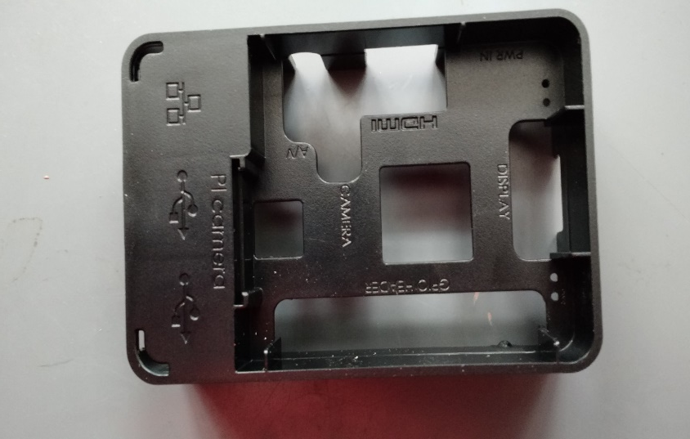
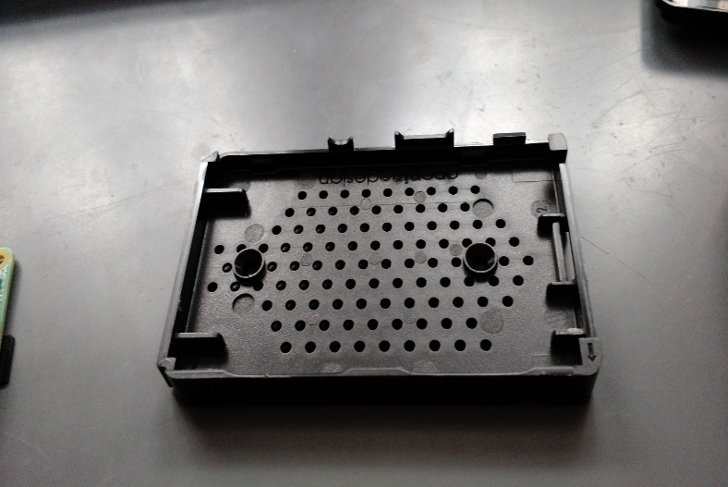
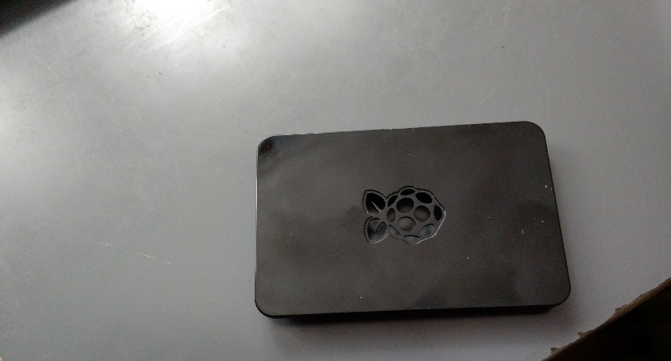
Build Your Pi Case box
Open Case box 3 pieces to case, base, sides and top

Slide 8
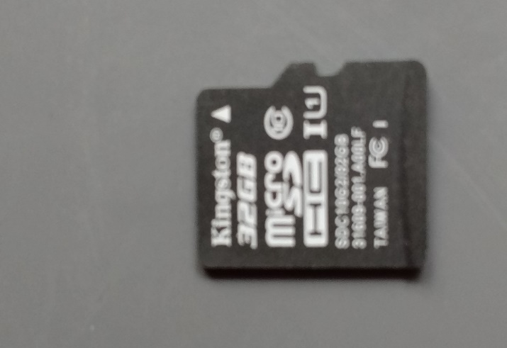
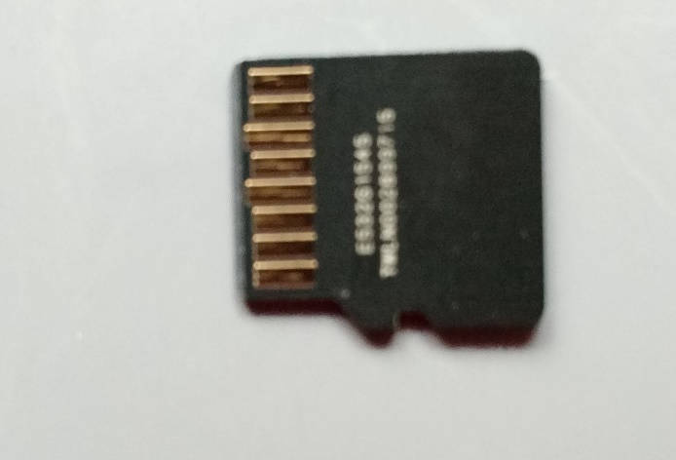
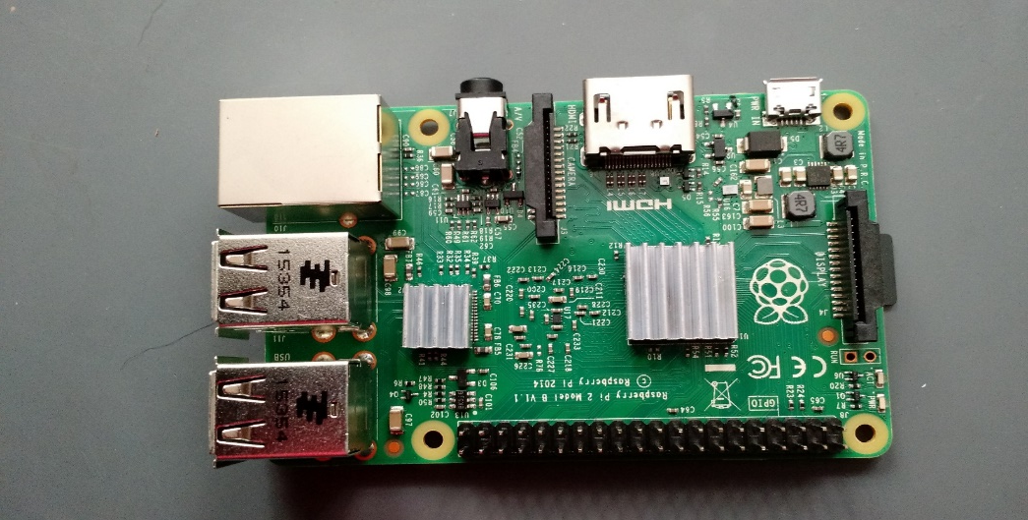
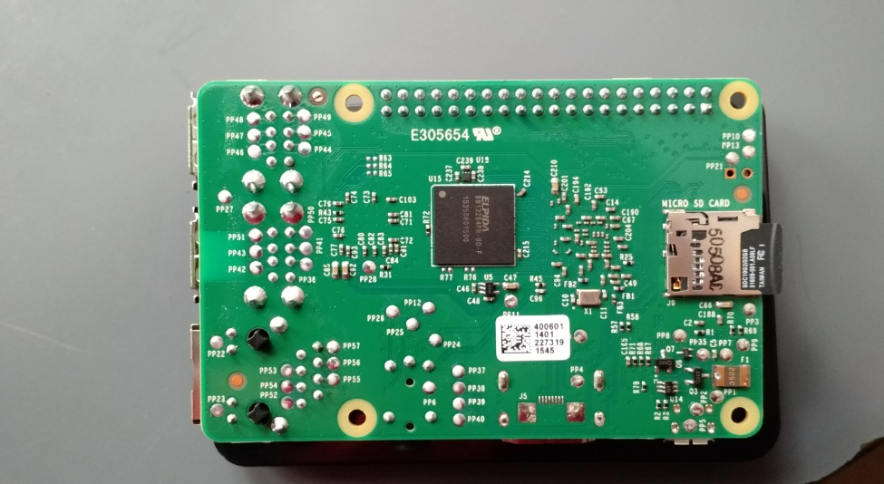
Build Your Pi Motherboard and SD Card
From the Raspberry Pi 3 Box, we should have heat sinks, SD card and motherboard.

Slide 9
Build Your Pi
Our first job is to place the motherboard onto the base of the case.
Remove the motherboard from it’s insulated bag, be sure to ground yourself before doing so. Place it on the base.
Open SD bag. Note that on one side there is writing, when you install the SD card make sure you can see the writing. Also note that the SD card has a notch on it, to help with correct installation.
Pick up the motherboard, holding it carefully by the sides, do not touch the surfaces. On the reverse side of the board there is the port for the SD card, put the SD card into the port. It should make a click.
Place motherboard on base of the case. Make sure SD card is below plastic beam.
Next align the case sides with usb ports and gently push the side case onto the base.

Slide 10
Build Your Pi

Slide 11
Build Your Pi
Put top on case and your build is complete!

Slide 12
Operating System Debian Linux
NOOBS – New Out Of the Box Setup is an easy operating system install manager for the Raspberry Pi.
Debian Linux is a Unix-like computer operating system and a Linux distribution that is composed entirely of free and open-source software,

Slide 13
History of Linux
LINUX is compatible with the POSIX-1003.1 standard and includes most of the functionality of UNIX System V and BSD.
Essential parts of the LINUX kernel was written by Linus Torvalds, a Finnish student of computer science.

Slide 14
Is Linux a version of UNIX?
Yes, it is another version of UNIX. People who share this point of view will point out how the commands and applications that run on Linux. This fact is mainly true because of the GNU Project, most of the software that gives UNIX systems their value has been developed under some form of open source model.

Slide 15
Linux is not UNIX
The strength of this argument lies in the fact that the Linux kernel was developed completely separate from known UNIX kernels. The Linux kernel was created by Linus Torvalds. In fact, it is modeled after Andrew Tanenbaum’s Minix.

Slide 16
Versions of Linux available for Raspberry Pi
RASPBIAN
PIDORA
OPENELC (media center)
RASPBMC (media center)
Minepeon (bitcoin)
Kali Linux (security/hacking)

Slide 17
NOOBs New Out Of Box software
In our kit we have an 32GB SD card which has a pre-installed version of Raspbian already on it.
This called a “New Out Of Box Software” or NOOBS installation. The only problem with this is that it only allows works fat file system and at most 32GB. This might not be satisfactory. Therefore other options must be used.
NOOBS is a boot loader

Slide 18
Raspberry Pi Website
BLOG – full of helpful resources and current topics around the raspberry pi
Downloads – area where versions of the operating system can be downloaded and directions to install
Community – wide variety of videos and tutorials
Help
Forums
Resources – sub topics of teaching, learning and making with raspberry pi

Slide 19
Obtaining Linux Raspberry Pi
Go to Raspberry Pi website, select downloads tab.
Download the image and formatting tool for SD cards. ( the compressed or zipped file)
If using windows (WindowsDisk32Manager) you will need to also download the formatting tool.
If using Linux you will need to use dd command to copy the uncompressed image onto the SD Card

Slide 20
First Boot
Expand file system to take full advantage of our storage space
Default user pi with password raspberry
Advanced option, allow ssh server ( secure shell server ) so we can connect remotely. We will need this later…
Reboot
Very quiet, any only uses approximately 1 amp.

Slide 21
Loading Process
Kernel
Services
Login

Slide 22
Commands?
Commands can be one of 4 different kinds:
An executable program files in /usr/bin. Within this category, programs can be compiled binaries such as programs written in C and C++, or programs written in scripting languages such as the shell, Perl, Python, Ruby, etc.
A command built into the shell itself. bash provides a number of commands internally called shell builtins. The cd command, for example, is a shell builtin.

Slide 23
More commands
A shell function. These are miniature shell scripts incorporated into the environment. We will cover configuring the environment and writing shell functions in later lessons, but for now, just be aware that they exist.
An alias. Commands that you can define yourselves, built from other commands.

Slide 24
Command Line Operation
ps – this command displays all running processes on our raspberry pi. We probably will only see two process running the operating system shell which we are using “bash” and the command we just executed ps.
If you want to learn Linux, the raspberry pi is an inexpensive platform for this.
Also great for programming. Java is included. To see this just type:
java -version

Slide 25
Network Address/ IP Address
Type ip a s – this command allows us to determine our IP address.
It also shows local connection (127.0.0.1), ethernet connection eth0 , wireless local access network or wlan0 connection.

Slide 26
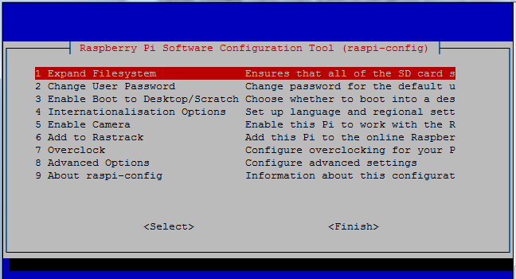
Raspberry Pi Configuration
raspi-config (requires administration priviledges) so we can use the sudo command to get to the setup menu.

Slide 27
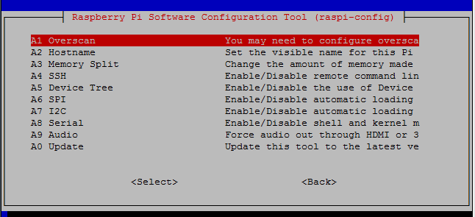
Advanced Options
Secure Shell Server

Slide 28
Storage Information
df –hT (show free space) root file system

Slide 29
Memory Available
Use the command free –h
Operating system available memory 927
Used 183
Free 743

Slide 30
What storage devices are available?
Use the command mount
Only mounted is the file system / on the SD card

Slide 31
Processor Information
Type uname –a displays all the information to the screen.
Type uname –r displays kernel version

Slide 32
Wireless Configuration
First choice use the GUI (Graphical User Interface)
Let’s do that now!

Slide 33
Wireless Configure Console
Scanning the wireless network use:
sudo iwlist wlan0 scan
Adding the network details to the Raspberry Pi
Open the wpa-supplicant configuration file in nano:
sudo nano /etc/wpa_supplicant/wpa_supplicant.conf

Slide 34
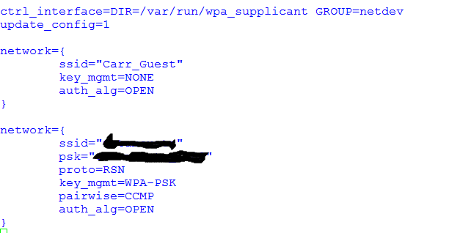
Example of wpa_supplicant.conf

Slide 35
Implementing Configuration Changes
sudo ifdown wlan0 – this turns the wireless connection off.
sudo ifup wlan0 - this turns the wireless connection on.
We can check to make sure the connection is successful by using this command:
ifconfig wlan0
If the inet addr field has an address beside it, the Pi has connected to the network.

Slide 36
Pi Users
User management in Raspbian is done on the command line. The default user is pi with the password raspberry. You can add users and change each user's password.

Slide 37
Change your password
Use passwd – this command will change your password. CAUTION, once changed you will need to store it somewhere.
Procedure:
Enter passwd on the command line and hit Enter.
You'll be prompted to enter your current password to authenticate, and then asked for a new password. Hit Enter on completion and you'll be asked to confirm it.
Note that no characters will be displayed while entering your password. Once you've correctly confirmed, you'll be shown a success message (passwd: password updated successfully) and the new password will be in effect immediately.

Slide 38
sudo (superuser doer)
sudo (/ˈsuːduː/ or /ˈsuːdoo/) is a program for Linux computer operating systems that allows users to run programs with the security privileges of another user, including the superuser.
The default pi user on Raspbian is a sudoer. This gives the ability to run commands as root when preceded by sudo, and to switch to the root user with sudo su.

Slide 39
Giving su privileges to regular users
To change a normal user into a sudoer. This procedure can only be completed by an existing super user. The following procedure must be used:
type sudo visudo and find the line root ALL=(ALL:ALL) ALL, found under the commented header '# User privilege specification'. Copy this line and switch from root to the username. To allow passwordless root access, change to NOPASSWD: ALL

Slide 40
Creating a new user
You can create additional users on your Raspbian installation with the adduser command.
Procedure –
Enter sudo adduser bob and you'll be prompted for a password for the new user bob. Leave blank for no password.

Slide 41
What happens when a new user is added?
Creation of home directory
Creation of a default user profile is created. The default user profile will be copied from the contents of /etc/skel/ will be copied to the new user's home folder. You can add or modify dotfiles such as the .bashrc in /etc/skel/ to your taste and this version will be applied to new users created.

Slide 42
User Profiles
A normal user profile is described through the following hidden files.
.bashrc
.bashlogout
.profile
pistore.desktop

Slide 43
There’s no place like /home
In the Linux/Unix operating system world, the common default user directory is placed under the home directory.

Slide 44
Directory System
File system is based on the concept of a “rooted” tree.
/

Slide 45
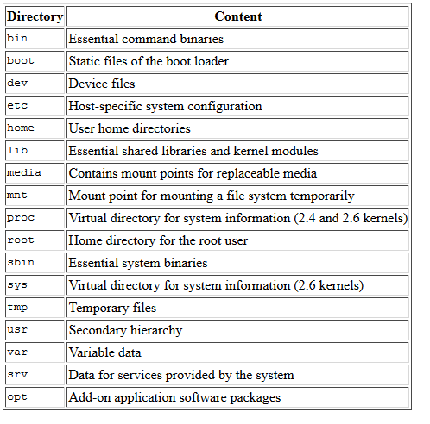
Part of the Raspberry File System

Slide 46
Deleting a user
You can delete a user on your system with the command userdel. Apply the -r flag to remove their home folder too:
sudo userdel -r bob

Slide 47
Common File System

Slide 48
Files
Most common commands for manipulating files:
cp ( copy )
mv ( move )
rm ( remove )
chown ( change ownership )
mkdir ( make directory )
touch ( create empty file )

Slide 49
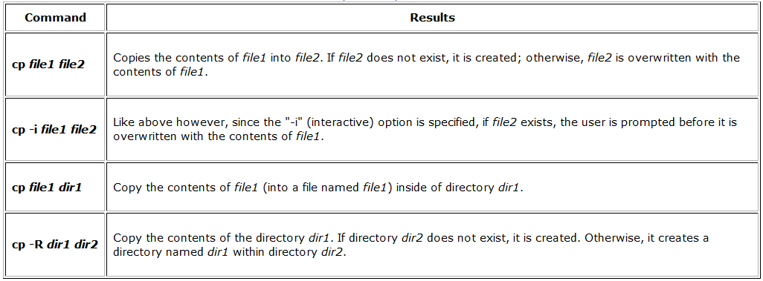
cp (copy)

Slide 50
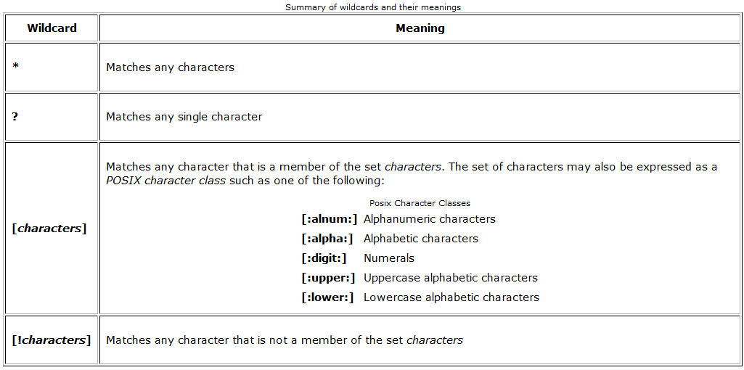
Wildcards
Wildcards allow you to select filenames based on patterns of characters.

Slide 52
mv (move)
The mv command performs two different functions depending on how it is used. It will either move one or more files to a different directory, or it will rename a file or directory. To rename a file, it is used like this:
[carr@... ~]$ mv file1 file2
If file2 does not exist, then file1 is renamed file2. If file2 exists, its contents are replaced with the contents of file1.
[carr@... ~]$ mv file1 directory
Moves file1 to the directory

Slide 53
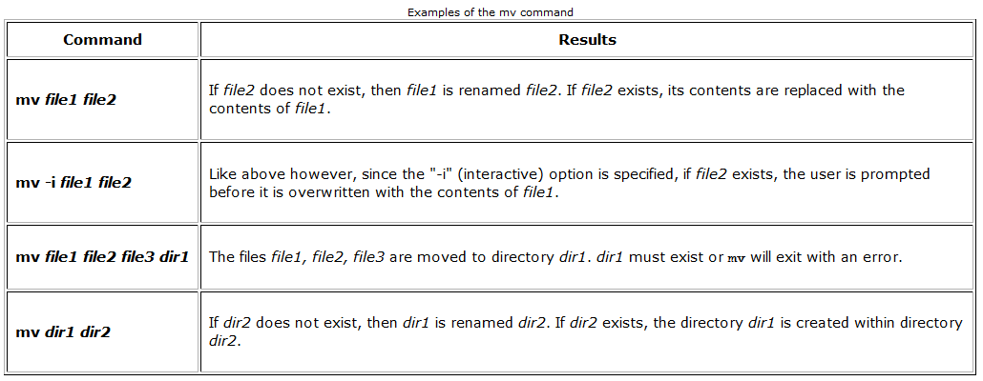
mv summary

Slide 54
rm (remove)
The rm command deletes (removes) files and directories.
Be careful with rm!
Linux does not have an undelete command. Once you delete a file with rm, it's gone.

Slide 55
Examples of rm

Slide 56
mkdir (make directory)
The mkdir command is used to create directories.

Slide 57
type
The type command is a shell builtin that displays the kind of command the shell will execute, given a particular command name. It works like this:
type command where “command” is the name of the command you want to examine.

Slide 58
which
Sometimes there is more than one version of an executable program installed on a system. While this is not very common on desktop systems, it's not unusual on large servers. To determine the exact location of a given executable, the which command is used:
Try it. which ls

Slide 59
Command Documentation
help command
man command

Slide 60
I/O Redirection
A powerful feature used by many command line programs called input/output redirection.
Standard output
Most command line programs that display their results do so by sending their results to a facility called standard output. By default, standard output directs its contents to the display. To redirect standard output to a file, the ">“ character is used.

Slide 61
Standard output appending to existing file
When the results are appended, the new results are added to the end of the file, thus making the file longer each time the command is repeated. If the file does not exist when you attempt to append the redirected output, the file will be created.

Slide 62
Standard Input
Many commands can accept input from a facility called standard input. By default, standard input gets its contents from the keyboard, but like standard output, it can be redirected. To redirect standard input from a file instead of the keyboard, the "<" character is used.

Slide 63
Combining < and >
Using this combination,
command < file1 > file2
the command will receive input from file1 and
output will be written to file2

Slide 64
Pipelines
The most useful and powerful thing you can do with I/O redirection is to connect multiple commands together with what are called pipelines. With pipelines, the standard output of one command is fed into the standard input of another.

Slide 65
Filters
Filters take standard input and perform an operation upon it and send the results to standard output. In this way, they can be combined to process information in powerful ways.

Slide 66
Common filters
sort: Sorts standard input then outputs the sorted result on standard output.
uniq: Removes duplicate lines of data.
grep: Examines each line of data it receives from standard input and outputs every line that contains a specified pattern of characters.
head: Outputs the first few lines of its input.
tail: Outputs the last few lines of its input.

Slide 67
Permissions
File permissions: Ability to r)ead, w)rite, e(x)ecute.
Directory permissions: same format
Ownership: Creator(s) of files or directories.

Slide 68
chmod
The chmod command is used to change the permissions of a file or directory.
rwx rwx rwx = 111 111 111 = 777
rw- rw- rw- = 110 110 110 = 666
rwx --- --- = 111 000 000 = 700

Slide 69
chown
Change the owner of a file by using the chown command. Notice that in order to change the owner of a file, you must be the superuser or su doer. To do this, our example employed the su command, then we executed chown.

Slide 70
chgrp Changing Group Ownership
The group ownership of a file or directory may be changed with chgrp. Note: You must be the owner of the file or directory to perform a chgrp.

Slide 71
Writing Your First Script
To successfully write a shell script, you have to do three things:
1. Write a script
2. Give the shell permission to execute it
3. Put it somewhere the shell can find it
Writing A Script
A shell script is a file that contains ASCII text. To create a shell script, you use a text editor. A text editor is a program, like a word processor, that reads and writes ASCII text files.

