Slide 1
Talking Malware Analysis with MITRE
Jonathan Jones | Michael Long
Approved for Public Release; Distribution Unlimited. Public Release Case Number 18-3817

Slide 2
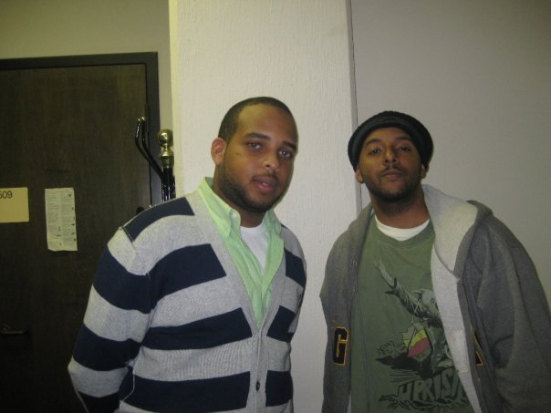
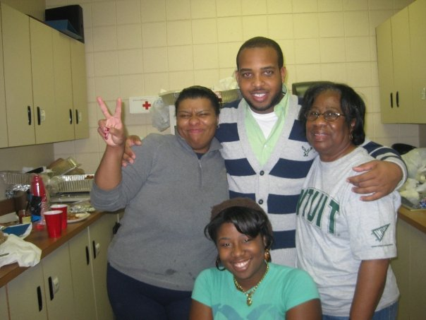
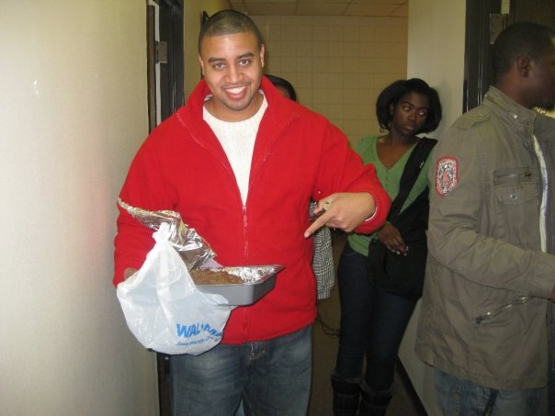
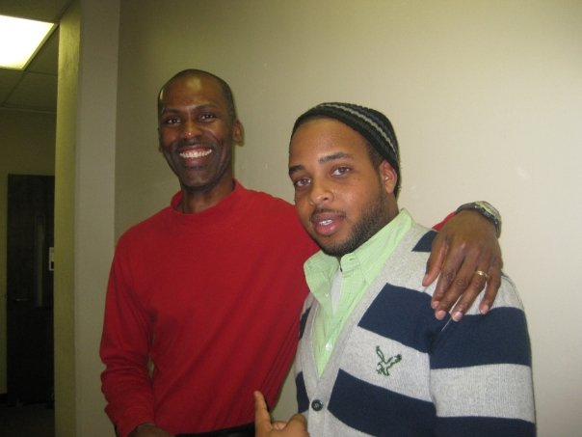
Meet the MITRE Conversation Starters
We are Comp Sci Aggies
Michael Long
Cyber Security Engineer
BS and MS in Computer Science
Jonathan Jones
Cyber Security Engineer
BS and MS (SFS) in Computer Science

Slide 3
Why we are here
MITRE is looking to engage with Students at NCATSU with real world challenges and activities.
Discuss high level topics with students in various areas related to Cyber Security/Cyber Operations
Initial topic: Malware Analysis
We want to be able to explain the who, what, how, and why at a high level
Assist in developing subject matter expertise among students who may be interested in this area of cyber security
Any questions about malware analysis after presentation let us know!

Slide 4
Malware Analysis

Slide 5
The Syllabus
What is Malware Analysis & Why Does it exist?
Malware Types
How To Perform Analysis
Static Analysis
Dynamic Analysis
More Tools
Quick Tip
Demo(s)

Slide 6
Malware Analysis What is Malware Analysis & Why Does it exist?
What
“The art of dissecting malware to understand how it works, how to identify, and how to defeat or eliminate it”
Practical Malware Analysis: A Hands-On Guide to Dissecting Malicious Software 1st Edition (Michael Sikorski, Andrew Honing)
Studying the malicious behavior of software
Monitoring malicious software in a controlled environment
Why
To assess damage to systems
Discover indicators of compromises
C2 (command-and-control)
Understanding of intruders
Is this an advanced persistent threat (APT), or
Crimeware
Determine the purpose of the malware

Slide 7
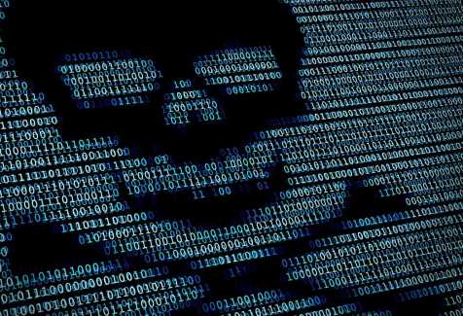
Malware Analysis Malware Types
Virus
Worm
Trojan
Backdoor
Remote Access Trojan (RAT)
Ransomware
Bot
Downloader
Dropper
Potentially Unwanted Programs (PUP)
Adware
Spyware

Slide 8
Malware Analysis How To Perform Analysis
Safety 1st: Controlled Environment = Safe Environment
Never use your everyday use computer(s)
Use an old computer
Physical Machine where you can use clonezilla to restore to pristine state
Access to VirtualBox, VMWare?
VMs allow the use of snapshots and reverts
Access to an OS?
Windows, Linux
Analysis Type
Static (code) Analysis
Examining file attributes
Examining disassembled code
Dynamic (behavioral) Analysis
Run the malware - observe its impacts on the system
Run the malware in a debugger to examine the malware’s inner workings
Memory Analysis
Analyzing computer’s RAM for artifacts

Slide 9
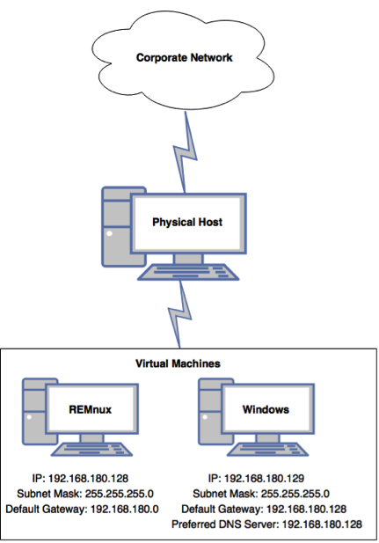
Malware Analysis How To Perform Analysis
Safety 1st: Controlled Environment = Safe Environment
Suggested Lab Environment
Physical Machine
Host OS should not be Windows
Virtual Environment
Windows VM
REMnux VM
Reverse-Engineering Malware Linux
Networking
Only allow network connections between the VMs
Never allow traffic to go out
Tips
Password protect malware samples in compressed file
Always take a snapshot of environment
Initial setup snapshot of VMs is ideal

Slide 10
Malware Analysis How To Perform Analysis
Safety 1st: Controlled Environment = Safe Environment
Advanced static analysis
Deep inspection of code to understand the inner workings of the malware
Reverse-engineering with a disassembler
Complex, requires understanding of assembly code
Advanced Dynamic Analysis
Run code in a debugger
Examines internal state of a running malicious executable

Slide 11
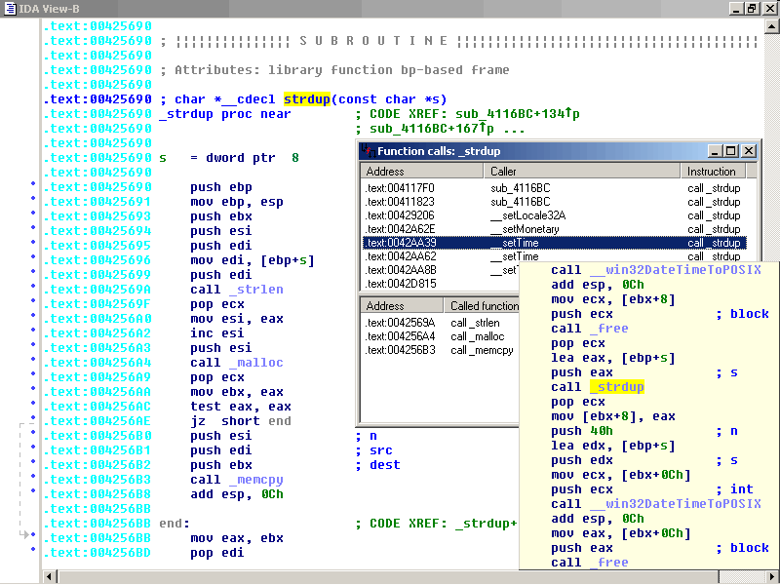
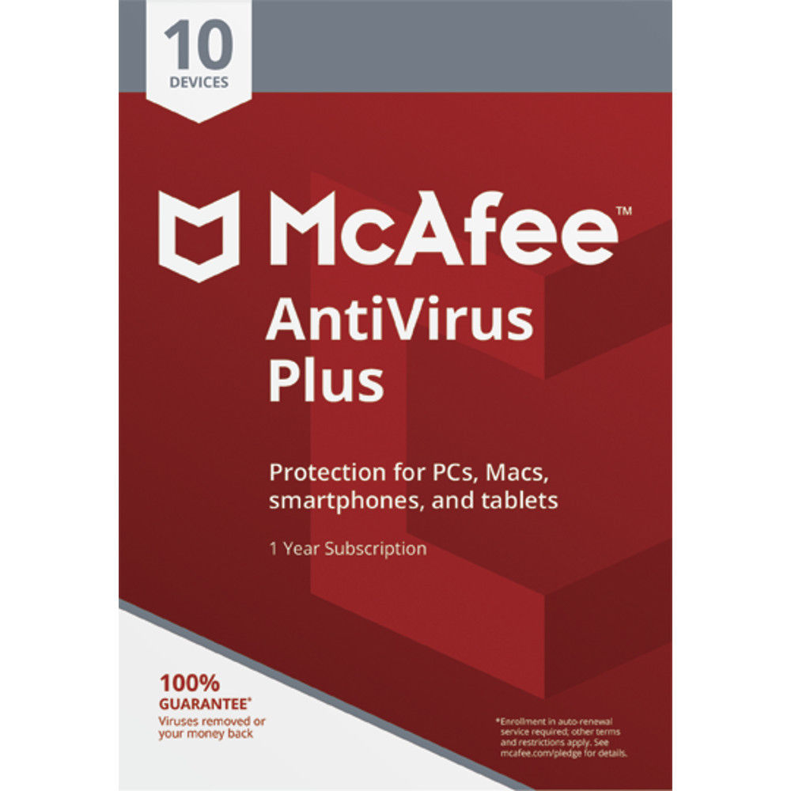
Malware Analysis Static Analysis
Safety 1st: Controlled Environment = Safe Environment
Tools we can use
Anti-Virus Engines
Hash (md5, sha1, sha256)
YARA
Strings
IDA Pro
PEView
PEiD
And many more

Slide 12
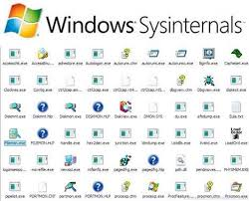
Malware Analysis Dynamic Analysis
Safety 1st: Controlled Environment = Safe Environment
Tools
FireEye (costs)
Cuckoo (Free)
WireShark (Free)
SysInternals (Free)
Process Hacker
What we look for
IP Addresses
Services/Processes
Registry Changes
File System Changes

Slide 13
Malware Analysis More Tools
Multiscanner
Developed by MITRE
Combines Static and Behavioral Analysis
Hosted on Github
It’s FREE!!!
VirusTotal
Submit Files for Analysis
Be careful for what you submit
Paid members can download
Threat Actors submit samples

Slide 14
Malware Analysis Quick Tip
Don’t Get Caught in Details
Focus on key features
Try Several Tools
If one tool fails, try another
MITRE does not endorse a specific tool. Find one which works best for you.
Don’t get stuck on a hard issue, move along
Malware authors are constantly raising the bar
Malware Analysis requires continuous learning
Work with peers, public forums, research
Come to MITRE

Slide 15
DEMO
Notes:
This slide is a placeholder for a visual demonstration that will take place, demonstration will be of…
Demo virtual malware environment on personal laptop
Personal Laptop is a Mac Book
Virtual environment is running REMnux and Windows
Turn on fakedns in REMNUX (allows to act as dns resolver for malicious programs looking to connect to outside world)
Turn on WireShark in REMNux (allows to catch packets being sent from REMnux)
Turn on Process Monitor on Windows (Allows to see what processes are currently running, what processes start other processes after execution on host)
Execute malware on Windows Machine after a snap shot has been taken
Monitor activity on Process Monitor after execution, note what process(es) have started
Monitor packets being captured in REMnux
Monitor network traffic being captured in REMnux for unusual traffic/connections being made
After demonstration, understand how just a small fragment of these findings can be used as Indicators of Compromise which can assist in creation of signatures and rules.

Slide 16
Resources
Practical Malware Analysis, Black Hat 2007
Kris Kendall and Chad McMillan
Awesome-Malware-Analysis
A curated list of awesome malware analysis tools and resources
Github Project
MITRE
Solving Problems for a Safer World
Do you have what it takes? Apply here

Slide 17
Resources
Free Training
http://opensecuritytraining.info/
REMnux: A Linux Toolkit for Reverse-Engineering and Analyzing Malware
https://remnux.org/
Lenny Zeltser
https://zeltser.com/

