Slide 1
Ed Carr Department of Computer Science North Carolina A&T State University carre@acm.org

Slide 2
Computer Science
Degree Programs
Undergraduate
B.S. Computer Science – 200
30% Female
Graduate
M.S. Computer Science – 50
40% Female
Ph.D. – 15
Departmental Personnel
Faculty
12 Tenured/Tenure-track, 1 Vacancy
2 Non-Tenure Track
Staff (2)

Slide 3
Computer Science
New Developments:
Scholarship for Service
$4k/month for 9 months
$1000/wk for 10wks in the Summer
Total: $46,000
Sandia National Laboratories CENC ML/ATR ($202K 8- month contract)
Total student support approximately $51K
NNSA Cybersecurity Consortium ($1M)
Total student support $55K per academic year

Slide 4
Industrial Advisory Board
New Relic
NetApp
CISCO
Google
Bank of America
Eli Lilly
Lockheed Martin
Northrup Grumman

Slide 5
Recent Graduates at Work
Government: CIA, FBI, NSA, NNSA, USAF, UNC-Ch, SNL (Post Doc)
Private: IBM, CISCO, MITRE, FireEye,Northrup Grumman, Lockheed Martin, Credit Swiss, Red Hat, Eli Lilly, Goldman Sacs …

Slide 6
Computer Science Ph.D. Program
North Carolina A&T State University

Slide 7
Doctor of Philosophy in Computer Science
Earned by the completion of required course work, research and dissertation.
Students must specialize in one of the research areas (Software Engineering, Secure Software Engineering, Cyber Security, Artificial Intelligence, others)
Meet all requirements for Ph.D. in CS (Non-Course Requirements)

Slide 8
Non-Course Requirements

Slide 9
Admission to Ph.D. Program
Requirements:
Option 1:
Master of Science in CS with GPA of at least 3.25
GRE: verbal score 450 (150 new scale) and quantitative score 700 (155 new scale)
Option 2:
B.S. in CS with GPA of at least 3.5
GRE verbal score of 500 (153 new scale) and quantitative score of 750 (159 new scale)

Slide 10
Current Research
Computational Framework for Identity
Extending the Use of WebIDs
Author Identification
Web Client Identification
Cyber Threat Identification
Malware and Forensics
Distributed Systems
Data Analytics

Slide 11
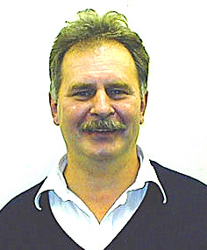
Dr. Albert C. Esterline
Computational Framework for Identity
Extending the Use of WebIDs
Identity Theory
Multagent Systems
Concurrency

Slide 12
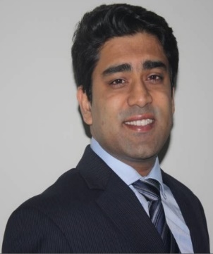
Dr. Kaushik Roy
Author Identification
Mitigating Replay Attacks
Biometrics
Big Data

Slide 13
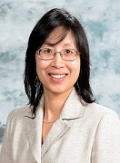
Dr. Xiaohong Yuan Chair
Web Client Identification
Cyber Threat Identification
Information assurance
Director of The Center for Cyber Defense

Slide 14
Grants
A&T is ranked third among UNC system in acquiring grant funding
Our department has been awarded recently grants from Department Of Defense, National Science Foundation, National Aeronautics and Space Administration, Naval Oceanographic Office, U.S. Air Force, and others…

Slide 15
Thank You!!!

